Slide 1
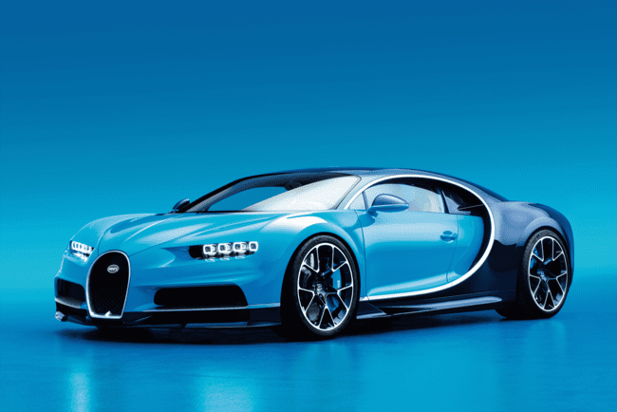
CAR PRICE PREDICTION
CAR PRICE PREDICTION
Team -3

Slide 2

TEAM -3
Srinadh
Vijay Karthik
Satya
Alekhya
Sampath
Sai kiran
Krishna
Rakesh

Slide 3

Description:
Car price prediction project involves building a machine learning model that can predict the price of a car based on various features such as company, model, year of manufacture, mileage, fuel type, and other relevant factors. This type of project can help for both car buyers and sellers, as it can help them estimate the fair market value of a car.

Slide 4



LANGUAGES :
FRONTEND:
BACKEND:
DATA SET
Cars data set

Slide 5
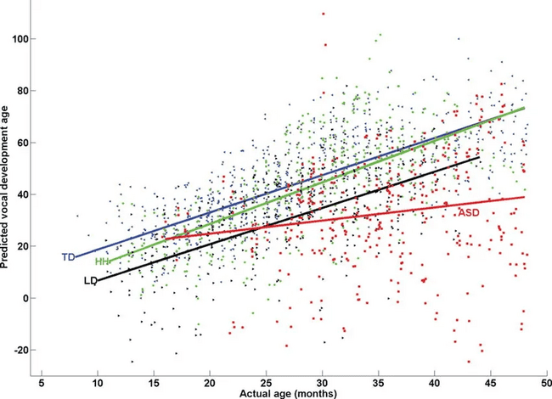
REGRESSION
Multiple Linear Regression :
Multiple regression is a statistical technique that can be used to analyze the relationship between a single dependent variable and several independent variables. The objective of multiple regression analysis is to use the independent variables whose values are known to predict the value of the single dependent value.

Slide 6

Multi Linear Regression Formula:
Y = Mx1 + Mx2 + Mx3 + Mx4 + ….. Mxn + c
Where :
Y= the dependent variable of the regression
M= slope of the regression
X1=first independent variable of the regression
x2=second independent variable of the regression
x3=third independent variable of the regression
C = constant

Slide 7
FLOW CHART
START
Importing
Data Set
Importing libraries
Exploratory data analysis
Loading data sets
Data preprocessing
Building and training the models
End
Making prediction on unknown dataset
Selecting the best model

Slide 8
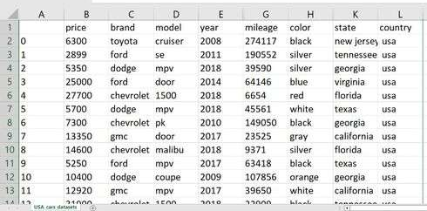
Sample Data set of cars:

Slide 9
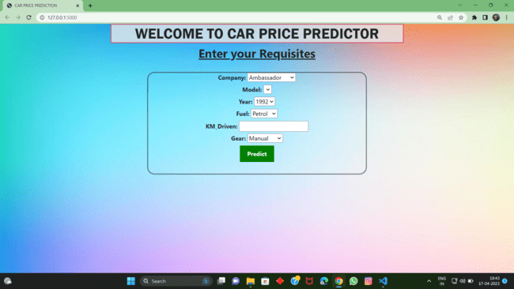
UI PAGE

Slide 10
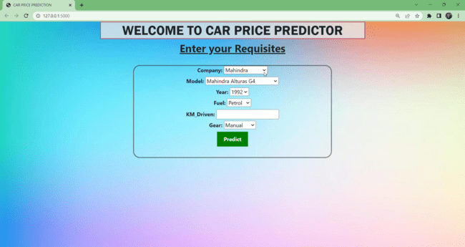
WORKING OF PROJECT

Slide 11

FUTURE ENHANCEMENT
We will be able to provide a new feature to upload DATASETS whatever the user wants
This time we will update our user interface by taking new features like Airbags(for user safety), Milage , car color , Engine CC ,Reverse Gear Camera and many more which will be able to predict the available cars and its models according to the user criteria.
We will make to predict the best accurate price.

Slide 12


